Slide 1

STRATEGY IMPLEMENTATION

Slide 2
“Successful strategy formulation does not guarantee successful strategy implementation.”
‘Strategy most often fail because they are not execute well.”

Slide 3
Strategy implementation is actually putting strategies into action.
The strategies formulated at various levels of the organization are implemented so as to achieve the objectives taken up at the corporate level.
Strategy implementation is a term used to describe the activities within an organization to manage the execution of a strategic plan.

Slide 4
Strategy implementation is the translation of chosen strategy into organizational action so as to achieve strategic goals and objectives.
Strategy implementation is also defined as the manner in which an organization should develop, utilize, and amalgamate organizational structure, control systems, and culture to follow strategies that lead to competitive advantage and a better performance.

Slide 5
Strategy implementation involves translating formulated strategies into action. It entails moving from “planning your work” to “working your plan”. Successful implementation of strategy requires the following;
Strategies must be communicated and clearly defined for all affected employees.
All affected employees must receive management support through having an appropriate organizational structure, empowering policies, sound leadership and effective reward systems.
Corporate and business-unit strategies must be translated into short-term objectives and functional strategies.

Slide 6
Strategy Formulation | Strategy Implementation
Strategy Formulation includes planning and decision-making involved in developing organization’s strategic goals and plans. | Strategy Implementation involves all those means related to executing the strategic plans.
In short, Strategy Formulation is placing the Forces before the action. | In short, Strategy Implementation is managing forces during the action.
Strategy Formulation is an Entrepreneurial Activity based on strategic decision-making. | Strategic Implementation is mainly an Administrative Task based on strategic and operational decisions.
Strategy Formulation emphasizes on effectiveness. | Strategy Implementation emphasizes on efficiency.
Strategy Formulation is a rational process. | Strategy Implementation is basically an operational process.
Strategy Formulation requires co-ordination among few individuals. | Strategy Implementation requires co-ordination among many individuals.
Strategy Formulation requires a great deal of initiative and logical skills. | Strategy Implementation requires specific motivational and leadership traits.
Strategic Formulation precedes Strategy Implementation. | Strategy Implementation follows Strategy Formulation.

Slide 7
Process of Strategy implementation:
Determination of clear goal and policies
Development of functional strategies and tactics
Development of programs, budgets and procedures
Managing conflict
Matching strategy with structure
Restructuring and reengineering
Linking performance and pay to strategies
Managing resistance to change
Creating a strategy supportive culture

Slide 8
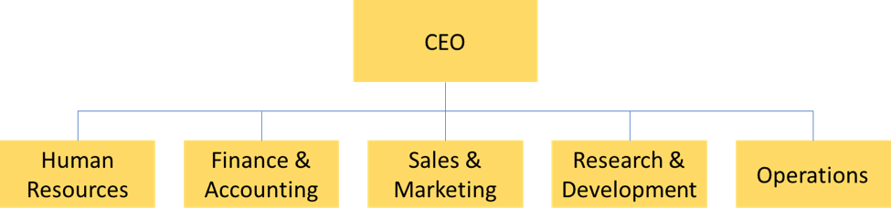
Types of organizational structure 1. Functional structure

Slide 9
It is where the organization units are defined by the nature of the work. Most organizations have four basic functions; production, sales, finance and human resources.
Each of the functions may be broken down where necessary e.g. the production department may be split into maintenance, quality control, engineering, manufacturing etc.
Employees are grouped by function and report to managers in the same area of functional expertise, who report to the CEO. Such structure is often used in organizations with a similar or narrow product line.

Slide 10
Advantages
Develops functional expertise
Enhances efficient use of resources through specialization
Centralized control of strategic decisions.
Disadvantages
Encourages narrow specialization when members of a functional group develop more loyalty to the functional group’s goals.
Conflict may develop among different departments striving for different goals
Limits the development of general managers
Decreases response time as the organization grows.

Slide 11
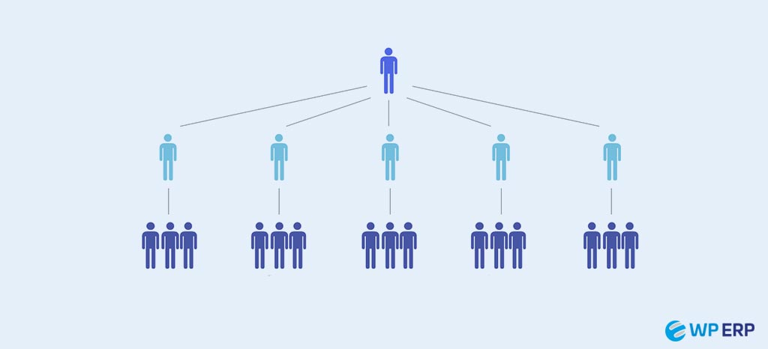
Simple structure

Slide 12
A simple structure is the most basic operating system that a business can use to centralize its activities. Also known as the flat structure, the simple organizational structure doesn't have multiple layers of management or formal departments. Instead, a simple organizational structure usually has one owner that delegates tasks to employees directly. Because the simple structure has no management personnel, the employees report to only the leader when they finish tasks.
As a company with a simple organizational structure grows, staff members may begin to specialize in tasks and skills. The owner may give some expert employees management positions, having them lead specializations of the business based on their most prominent skills. Once a business gains departments structures that focus on a single aspect of the organization, it's no longer a simple structure.

Slide 13
Advantage
Increase leader control
Improved efficiency
Elevated responsibility
Easier decision making
Few budget costs
Disadvantage
More leadership responsibility
Less employee autonomy
Possible confusion
Lack of specialist
Limited growth

Slide 14
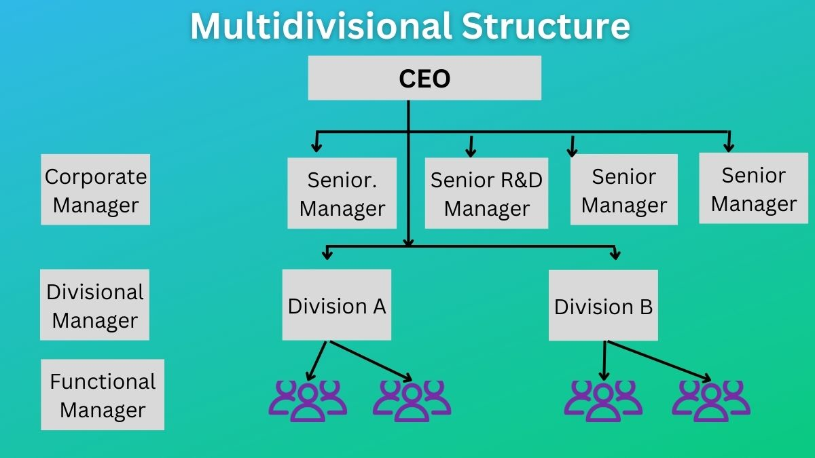

Slide 15
A multidivisional structure, also called M-Form is an organizational structure in which an organization is divided into different product divisions. Each division works independently and is responsible for its performance.
It consists of a complex organizational structure with separate business divisions each working independently. When a firm has different products and operates in a wide range of geographical areas the multidivisional structure is a viable option.

Slide 16
Advantage
Organization effectiveness
Helps in expansion
Create portfolio
Promotion
Create synergy
Disadvantage
Poor coordination
Costly structure
Too much autonomy
May compete for scare resource

Slide 17
Matrix structure
Also called “project” structure is a way of forming project teams within the traditional organization. A project is a combination of human, finance, raw material and machinery resources pooled together in a temporary organization to achieve a specified purpose. The development of a new product would be an example of a project.
Employees working on a project are officially assigned to the project and to their original department. A project manager is given the authority for meeting the project objectives in terms of cost, quality, quantity and completion time. When the project work is done, the project team is dissolved and the functional personnel return to their departments.

Slide 18
Advantages
Simultaneously accommodates several project- oriented business activities
Facilitates co-operation and coordination of related activities.
Provides for training experience for strategic managers.
Disadvantages
Can result in confusion and contradicting policies.
Requires a lot of vertical and horizontal coordination.
May result in slow decisions.

Slide 19
Network Organizational Structure:
A network organizational structure is one in which organizations group certain types of employees together based around a common specialization. These employees then form partnerships with other specialists from throughout the organization to take on new projects and work toward a common goal.
For instance, a company may have a product development team and a marketing team, each operating as different divisions. However, when new projects arise, members of those teams can pair up to tackle projects together.

Slide 20
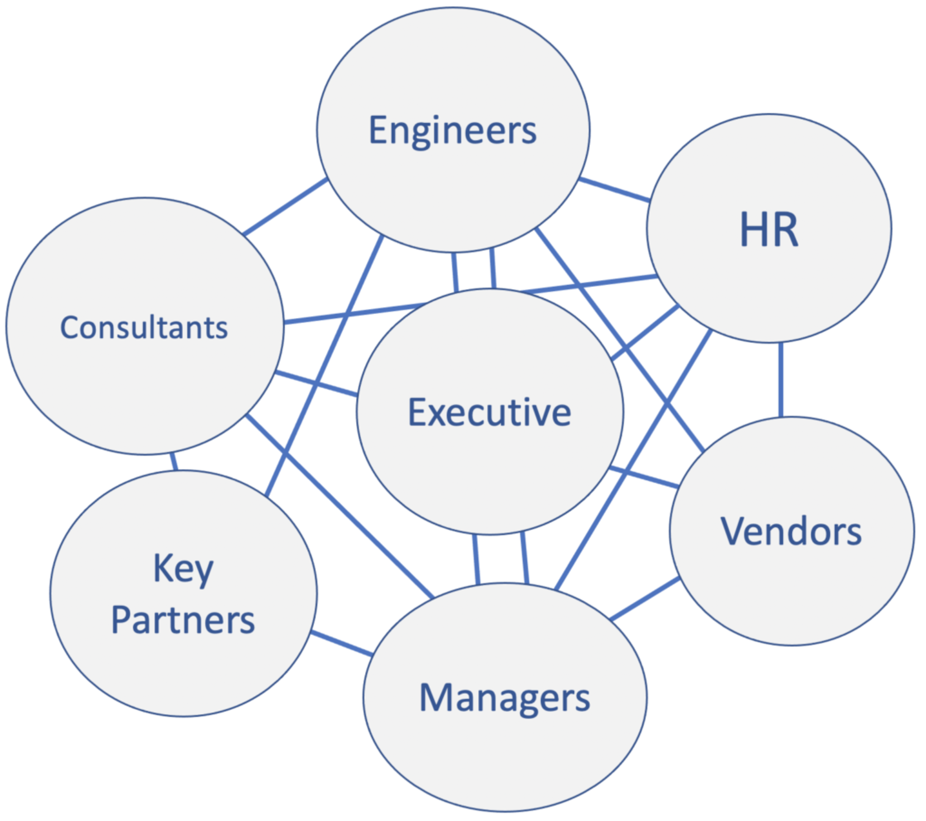

Slide 21
Pros:
Encourages collaboration and communication
Employees encouraged to take the initiative in key decisions
Cons:
Requires more complex relationships within the fluid organizational structure
Lacks easy-to-understand hierarchies

Slide 22
Strategic Leadership:
Strategic leadership is a practice in which executives, using different styles of management, develop a vision for their organization that enables it to adapt to or remain competitive in a changing economic and technological climate.
Strategic leaders can use this vision to motivate employees and departments, fostering among them a sense of unity and direction to implement change within their organization.

Slide 23
The Role of Strategic Leadership:
Determining strategic directions;
Effectively managing the firms resource
Providing information
Sustaining an effective organizational culture and ethical practices
Establishing balanced organizational controls
Managing conflict
Managing resistance to change

Slide 24
Leadership and Management
Leadership and management are the terms that are often considered synonymous. It is essential to understand that leadership is an essential part of effective management.
As a crucial component of management, remarkable leadership behavior stresses upon building an environment in which each and every employee develops and excels.
Leadership is defined as the potential to influence and drive the group efforts towards the accomplishment of goals. This influence may originate from formal sources, such as that provided by acquisition of managerial position in an organization.
A manager must have traits of a leader, i.e., he/she must possess leadership qualities. Leaders develop and begin strategies that build and sustain competitive advantage.
Organizations require robust leadership and robust management for optimal organizational efficiency.

Slide 25
Differences between Leadership and Management
While managers lay down the structure and delegates authority and responsibility, leaders provides direction by developing the organizational vision and communicating it to the employees and inspiring them to achieve it.
While management includes focus on planning, organizing, staffing, directing and controlling; leadership is mainly a part of directing function of management. Leaders focus on listening, building relationships, teamwork, inspiring, motivating and persuading the followers.
While a leader gets his authority from his followers, a manager gets his authority by virtue of his position in the organization.
While managers follow the organization’s policies and procedure, the leaders follow their own instinct.
Management is more of science as the managers are exact, planned, standard, logical and more of mind.
Leadership, on the other hand, is an art. In an organization, if the managers are required, then leaders are a must/essential.

Slide 26
VII. While management deals with the technical dimension in an organization or the job content; leadership deals with the people aspect in an organization.
VIII. While management measures/evaluates people by their name, past records, present performance;
IX. Leadership sees and evaluates individuals as having potential for things that can’t be measured, i.e., it deals with future and the performance of people if their potential is fully extracted.
X. If management is reactive, leadership is proactive.
XI. Management is based more on written communication, while leadership is based more on verbal communication.

Slide 27
Learning Organization
A learning organization is a company that continuously learns and develops itself through the process of creating new knowledge.
The goal is to create a culture where employees are encouraged to learn and grow, which leads to sustainable competitive advantage.
Learning organizations regularly learn new processes and adapt to change. They are businesses that use the knowledge of the employees, customer feedback, and data to make decisions and improve their processes.

Slide 28
Emotional Intelligence and leadership Performance
Emotional intelligence is the ability to recognize, understand and manage your own emotions as well as being able to understand and influence the emotions of others. It involves being aware that emotions drive behaviors and impact people either positively or negatively.
While emotional intelligence can seem like a vague or complex concept, there are specific ways you can develop this skill. Taking time to hone and build on these skills can help you become better at building relationships and accomplishing shared tasks.

Slide 29
EI can be helpful when you are:
Giving or receiving feedback
Navigating change
Meeting tight deadlines
Working through setbacks and failure
Dealing with challenging relationships

Slide 30
Components of emotional intelligence:
1. Self-awareness
Self-awareness is about recognizing and understanding your emotions – what you’re feeling and why – as well as appreciating how they affect those around you. It’s the basis of good intuition and decision-making, helping you to instinctively make the right choices for you in all aspects of life. Self-awareness is also about knowing your strengths and weaknesses, and what is important to you – your values or moral compass.
2. Self-regulation
Once you’ve mastered emotional awareness, the next step is managing those emotions – particularly the negative ones – effectively. Always treat others with respect and try to stay in control. If you have a tendency to emotional outbursts, practice being calm: step back and take a deep breath. It’s also important to stay true to your values, and hold yourself personally accountable for any mistakes.

Slide 31
3. Motivation
The third ‘personal’ element, motivation is about your drive to improve and achieve: setting high standards for yourself and working consistently towards your goals. Take the initiative: be ready to act on opportunities as they come along, and practice being assertive. Motivation is also about optimism and resilience, and finding the positive in a situation, even – or especially – those that didn’t go well.
4. Empathy
A key interpersonal skill, empathy is the ability to put yourself in someone else’s shoes and see a situation from their perspective. As well as having an awareness of others’ feelings, it’s important to acknowledge and respond to them – even if you don’t agree with them. Respecting diversity and inclusion is a vital aspect of empathy, as is communication: pay close attention to what you and others say, whether verbally or through body language.

Slide 32
5. Social skills
Often described as a ‘people person’, those who are socially skilled are adept at dealing with others. They are trustworthy team players and confident communicators: as good at listening to other people as they are at speaking themselves. They also make great leaders, inspiring and motivating colleagues, managing change and resolving conflict effectively, and giving praise where it’s due.

Slide 33
Leadership Capability:
A leadership capability framework outlines the capabilities required in leaders in order to achieve key business objectives.
It creates a common language around what “good” and effective leadership looks like in an organization, making it a unique and exclusive framework to your business.
Leadership capabilities are sense making, relating, visioning and inventing.
Sense making: It is required to know where to go and what to do ?, internal and external activities of the company.
Relating: who those people are, what they think, how they view the situation ?
Visioning: It is the creation of possible picture of future where the organization will be in near future.
Inventing: It is the implementation and execution with a creativity.

Slide 34
Corporate culture and leadership:
Culture is a system of values, belief and behaviors that shape how real work gets done in an organization.
An organizational culture is defined by how people inside the organization interact with each other
It’s the leader duty to uphold the values and beliefs of the organizations culture through their actions and decisions

Slide 35
Effective leadership;
An effective leader should;
Fit with the culture and model desired behaviors
Understand his/her fit with the culture and use that awareness to drive positive change
Connect with employees hearts and minds, aligning to common purpose
Change the culture means changing mind
Changing culture is a large-scale undertaking, that seeks to modify process, rules attitudes, behavior, and most importantly the minds of the people in the organization.

Slide 36
Changing an organizations culture is one of the most difficult leadership challenges
An organization culture permeates into every facet of its being, in its goals, rules, communication practices, attitudes and more
These elements fit together as an mutually reinforcing system that prevents any attempt to change it.
A few organizational tools for changing minds, coupled with a dedicated and strong leadership , can however bring about change

Slide 37
Changing Minds in 3 Phases
In general, the most fruitful success strategy to bring about change in an organization is to begin with leadership tools that project a vision or story of the future
The next step would be cement the change in place with management tools, such as role definitions, measurement and control system.
The use of pure power tools like coercion and punishment can be used as last resort, when all else fails.

Slide 38
Concept of strategic change:
Strategic change management is the process of managing change in a structured, thoughtful way in order to meet organizational goals, objectives, and missions.
Change is necessary for organizations to continue to thrive and meet and exceed the competition of industry competitors.
Strategic change is the movement of a company away from its present state toward some desired future state to increase its competitive advantage.

Slide 39
Business environment is dynamic in nature,
Strategies are formulated and implemented to cope with the environment dynamism
When current strategy loses relevancy in terms of addressing the environmental issues strategic change is needed,
Strategic change is a way of changing the objectives and vision of the company
leading Strategic change involves the following;

Slide 40
Understanding the forces of change:
Both external and internal forces of the environment demand strategic change.
External Forces
Political forces, Economic forces, Socio-cultural forces, Technological forces, Legal forces and Global forces
Internal forces:
They are within the organization
They are controllable in long-run
They are; organizational objectives and policies, organizational culture, organizational resources, organizational structure.

Slide 41
2. Diagnosing the change situation:
In the process of managing strategic change, the change situation should be diagnosed. It involves the following steps;
Types of strategic change
The importance of context
Organizational culture
Force-Field Analysis

Slide 42
A. Types of strategic change
There is a no only way, or one best way, to change strategies.
The nature of change may be incremental or big bang.
Four types of strategic change;
Adaptation: can be accommodated with the existing culture and can occur incrementally.
Reconstruction: rapid change but without fundamentally changing the culture.
Revolution: fundamental changes in both strategy and culture.
Evolution: cultural change is required but this can be accomplished over time.

Slide 43
B. The importance of context:

Slide 44
Time: Is there time for longer term strategic development or does the firm have to react quickly to a crisis?
Scope: how much of the organization will be affected? Is the change best describe as realignment or transformation?
Preservation: which aspect of working, culture, competences and people need to be retained?
Diversity: the need to recognize that different departments ( eg. Marketing and R&D) may have different sub-cultures.
Capacity: whether abilities exist to cope with the change. These can be on an individual, managerial or organizational level.
Readiness: are staff aware of the need for change and are they committed to that change?
Power: how much authority and autonomy do change agents have to make proposed changes?

Slide 45
C. Organizational Culture:
For change to be effective an organization will often have to change its culture.
The extent of the change required will be influenced by the type of change that is planned.
For example, revolution is likely to require a greater cultural change than adaptation.
Very often the existing culture can be one reason for resistance to change-the culture becomes “ embedded”.

Slide 46
Culture is the set of values, guiding beliefs, understanding and ways of thinking that are shared by the members of an organization and is taught to new members as correct.
It is reflected by;
Common interest of the stakeholders
Teamwork and collaboration
Autonomy and power at work
Centralization and decentralization
innovation and risk taking

Slide 47
D. Forces-field Analysis:
Force Field Analysis was created by Kurt Lewin in the 1940s.
The idea behind Force Field Analysis is that situations are maintained by an equilibrium between forces that drive change and other that resist change,
For change to happen, the driving forces must be strengthened or the resisting forces weakened.

Slide 48
Managers should consider any change situation in terms of;
The factors encouraging and facilitating the change ( the driving forces)
The factors that hinder change ( the restraining forces).
If we want to bring about change we must disturb the equilibrium by;
Strengthening the driving forces
Weakening the restraining forces
Or both.

Slide 49
How to Use Force Field Analysis:
Step 1: Describe Your Plan or Proposal for change
Define your goal or vision for change
Step 2: Identify Forces For Change
Think about the kinds of forces that are driving change. These can be internal and external.
Internal drivers could include:
Outdated machinery or products lines.
Declining team morale.
A need to increase profitability.
External drives could include;
Change in technologies.
Changing demographic trends

Slide 50
Step 3: Identify Forces Against Change
Now brainstorm the forces that resist or are unfavorable to change.
Internal resistors and restrainers could include;
Fears of the unknown
Existing organizational structures
External factors might be;
Existing commitments to partner organizations.
Government legislation
Obligations towards customers

Slide 51
Step 4: Assign Scores
Next, score each force, from, say, one (weak) to five ( strong), according to the degree of influence each one has on the plan, and then add up the scores for each side ( for and against)
Step 5: Analyze and Apply
Now that you have done your Force Field Analysis, you can use it in two ways;
To decide whether or not to move forward with the decision or change.
To think about which supportive forces you can strengthen and which opposing or resisting forces you can weaken, and how to make the change more successful.

Slide 52
Styles and Roles in Change Management:
Styles of Managing Change:
Education and communication
Persuading people towards the strategic change and informing change to the stakeholders.
ii. Collaboration and Participation
It is the involvement of those who will be affected by strategic change, it builds readiness.
iii. Intervention
Intervention is the coordination of the change process
iv. Direction
It is the use of personal managerial authority to establish a clear future strategy.

Slide 53
b) Roles in Managing Change:
There are different individuals and groups within an organization who play active role in strategic change process.
Strategic leadership
Strategic leadership means having ability to anticipate, prepare and get positioned for the future.
Strategic leaders are individual upon whom strategy development and change are seen to be dependent
They are individuals personally identified with and central to the strategy of their organization.
In some organization an individual may be central because he /she was its owner or founder ; often the case in small business.

Slide 54
2. Middle Managers:
Middle manages are the linking pin between the senior management team and the rest of the organization.
They have responsibility for helping their staff through the change process while simultaneously undertaking change themselves.
3. Outsiders:
Outsiders are also equally important as mangers.
New Chief Executive: From outside, to enhance the capacity for change.
New management: From outside, to increase diversity of ideas and break down cultural barriers for change.
Consultants: Consultants may brings an innovative view to the process.

Slide 55
Levers for Managing Strategic Change
Levers are the components that drive the process of strategic change.
Structure and control
Organizational routines
Symbolic processes
Power and politics Processes
Communicating change
Change tactics

